Slide 1
Tech Interview Prep:
Guaranteed Structured Outputs & Production Schema Remediation
“How do you guarantee that an LLM outputs parseable JSON for downstream services, and how do you remediate schema drifting in production?”
1) How to guarantee structured output during generation
2) How to detect and remediate schema drift in production
Name: Dara Sen
Class: AD331 (Artificial Intelligence)

Slide 2
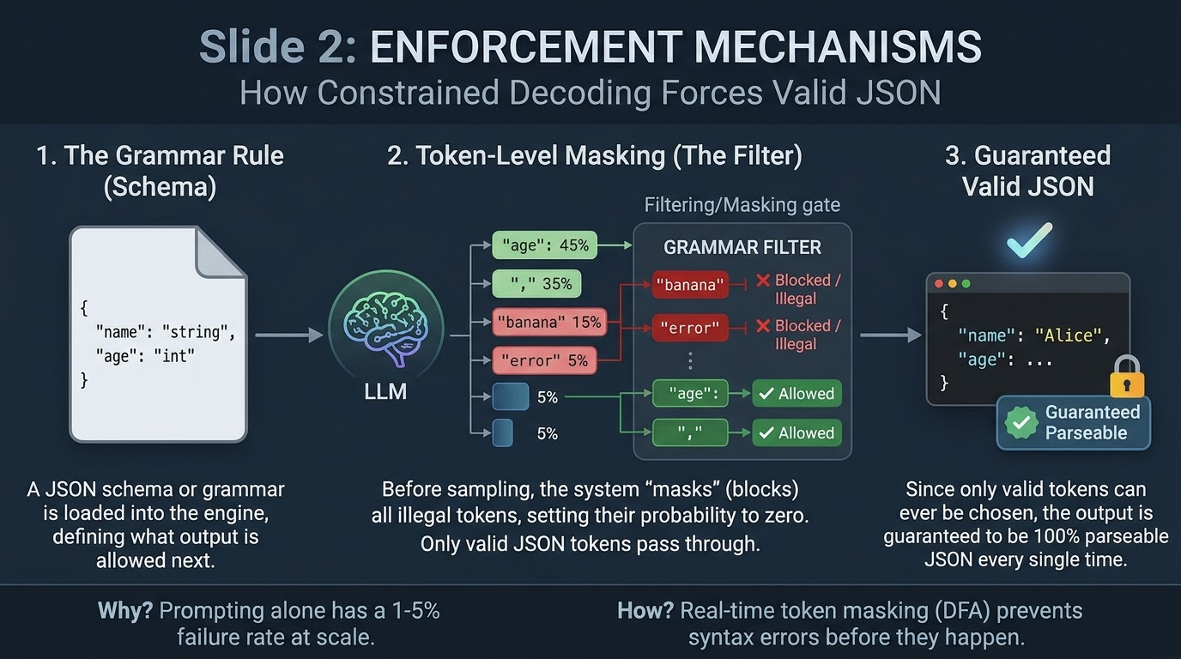
Enforcement Mechanisms: Token-Level Constrained Decoding

Slide 3
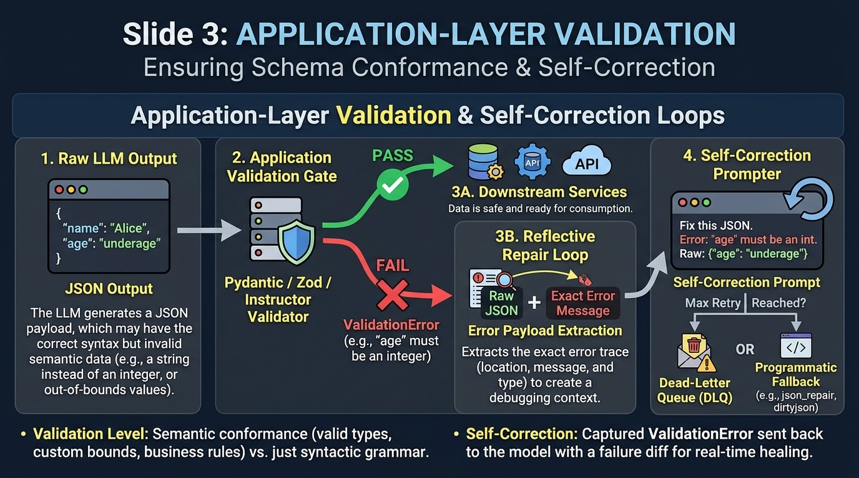
Application-Layer Validation & Self-Correction Loops

Slide 4
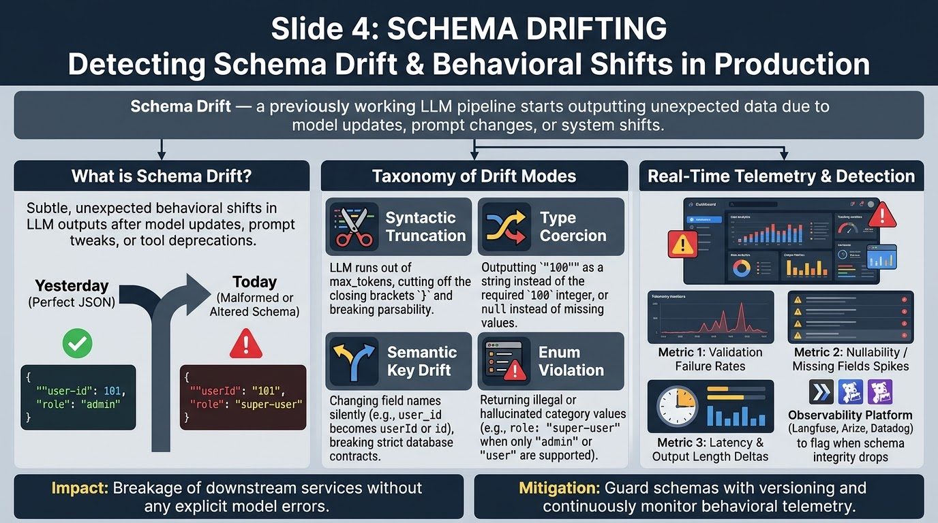
Schema Drifting in Production: Detection & Root Causes

Slide 5
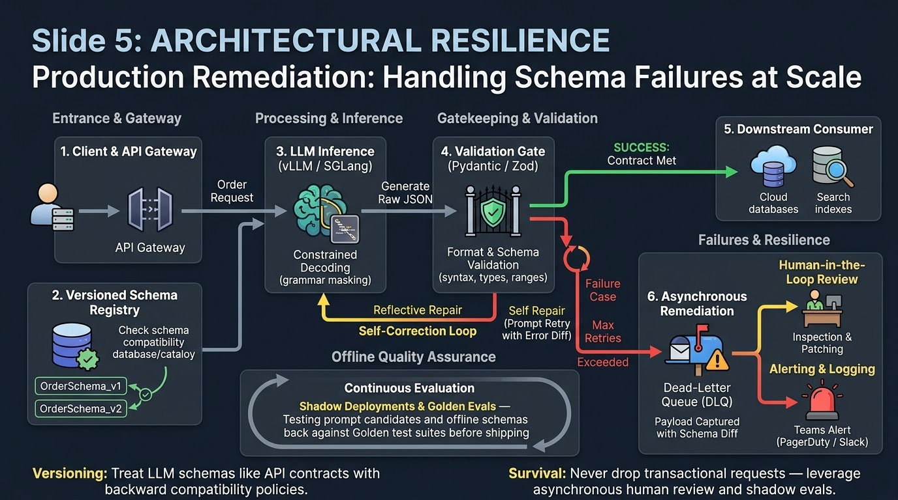
Production Remediation & Architectural Resilence

Slide 6
Summary & Systems Engineering Takeaways
Do not rely on prompt engineering alone BUT rely on constrained decoding for good syntax
Validate semantically at the application level using Pydantic or Zod
Implement Dead-Letter Queues (DLQs) for continuous monitoring

